Slide 1
Open data driven policy making AN2: Data and analysis

Slide 2

Welcome
Commissioned by
Delivered by
Dr David Tarrant
The Open Data Institute
Lucy Knight
Local Government

Slide 3
Aim
To equip policy makers with the knowledge and skills they need to effectively use open data in policy making

Slide 4
Introductions
NOTE; CSL should be the only logo on the cover page
Who are you?
What is your role in relation to data driven policy making?
What would you like to get out of this training?

Slide 5
Today
Introduction to open data driven policy making
Benefits, caveats and risks of using data in policy making
Planning a data driven policy process
Data driven policy making in practice

Slide 6
Data driven policy making
NOTE; CSL should be the only logo on the cover page

Slide 7
Introduction to data driven policy making
Outcomes
Define data, big data and open data.
Describe how data is used to inform policy making in different fields.
Identify the benefits of using data in policy making.
Assess the risks, caveats and limitations of using data in policy making.

Slide 8
Exercise
What is data?
In as few words as possible, define ‘data’.
You can use an example as an answer if you wish.
One twist: you cannot use the word information in your answer.

Slide 9
What is data?
A collection of facts, information and statistics that can be analysed to develop new knowledge.
A collection of numbers assigned as values to quantitative variables and / or characters assigned as values to qualitative variables.
The lowest level of abstraction from which information and then knowledge are derived.

Slide 10
How is data different from information?
Knowledge
Information
Data
(information without context)

Slide 11
Notes:
In other words, it is not about what we can achieve. But what we can help you achieve.

Slide 13
What did you see?
Data: What did you see?
Information: How did you interpret it?
Knowledge: Did it mean (or relate to) anything for you?
Notes:
In other words, it is not about what we can achieve. But what we can help you achieve.

Slide 14
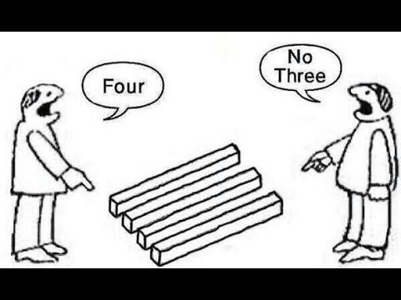
Seeing what isn’t there Even counting is difficult (more on that later)

Slide 15
Exercise
What is open data?
In as few words as possible, what is ‘open data’?

Slide 16
A piece of data or content is open if anyone is free to use, reuse, and redistribute it - subject only, at most, to the requirement to attribute and/or share-alike. Open Knowledge International

Slide 17
Data that anyone can access, use and share. The Open Data Institute

Slide 18
Open data is data that is published in an open format, is machine readable and is published under a license that allows for free reuse. data.gov.uk

Slide 19
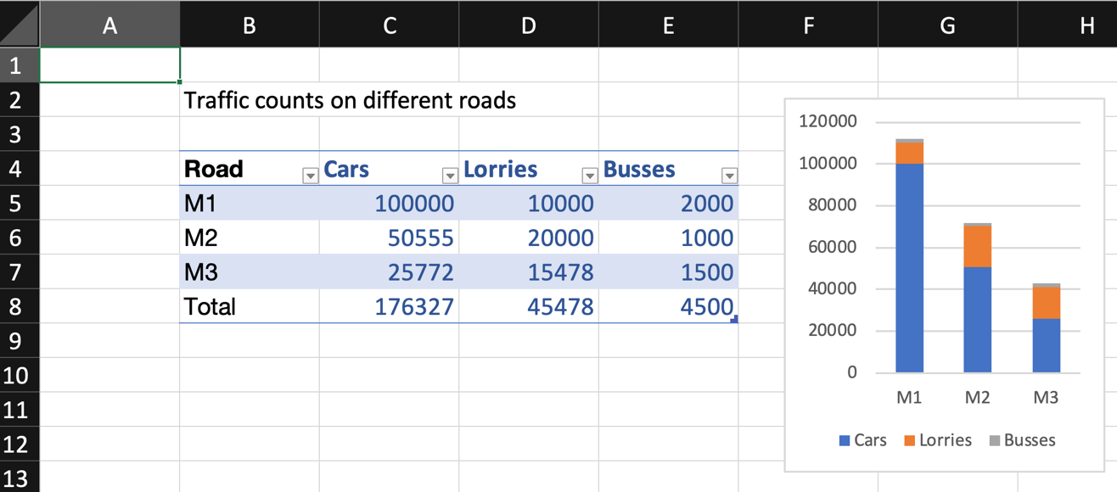
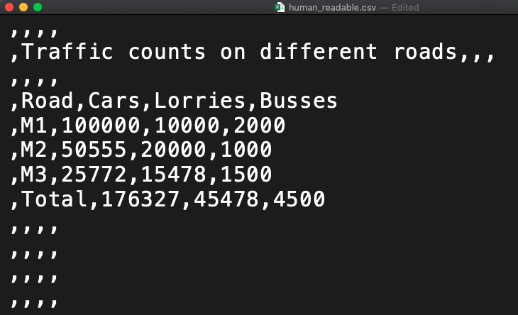
Machine readable data?

Slide 20
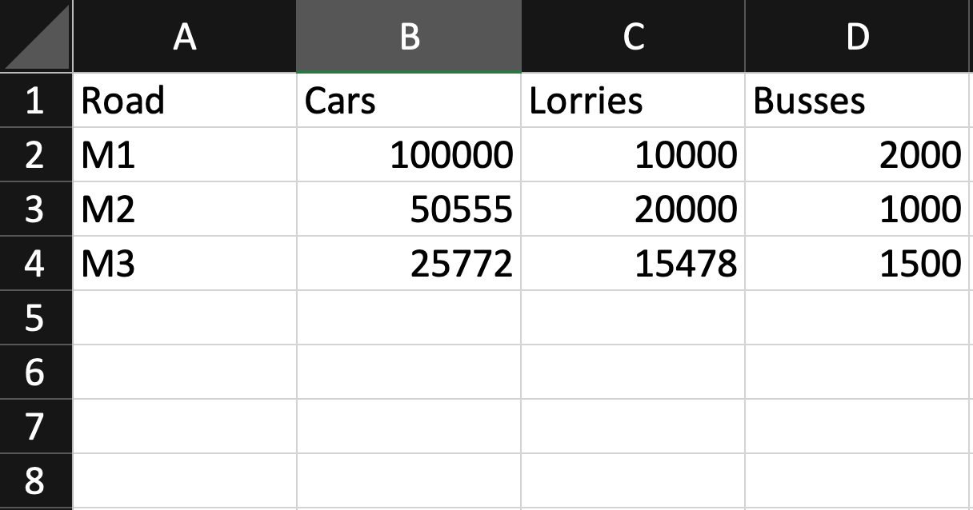
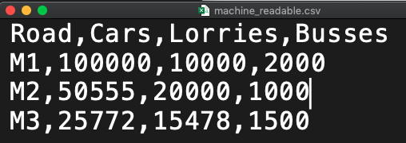
Machine readable data?

Slide 21
Open data
The important points are:
licensed openly (e.g. Open Government Licence)
free to use, not always free to access (currently government open data must be available at no cost)
users must be able to modify and redistribute the data
Data.gov.uk includes:
published in open format
machine readable

Slide 22
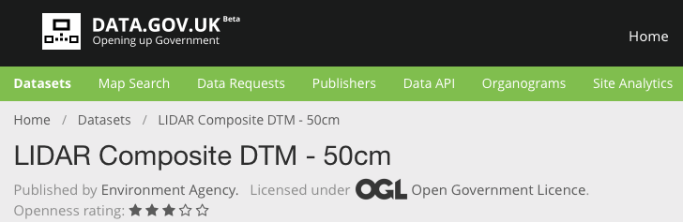
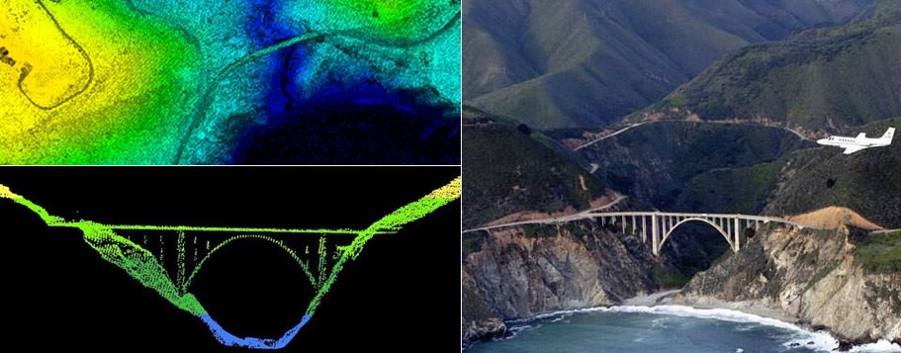
Case study: LIDAR

Slide 23
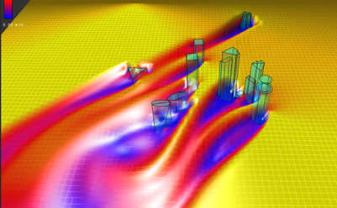
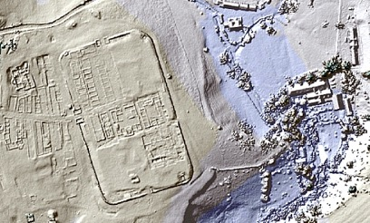
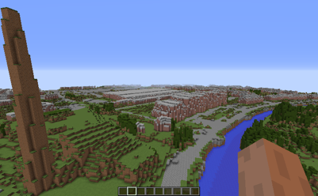
Impact of LIDAR data
Wind modelling
Archology
Educational games (Minecraft)

Slide 24
Video Q: What types and uses of data do Emily and David focus on?

Slide 25


Slide 26
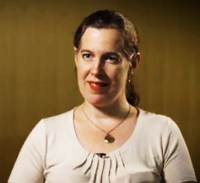
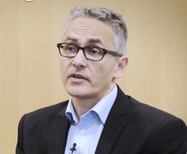
Review
What types of data do David and Emily focus on?
EMILY focusses on open data and data that is already showing benefit regardless of how big or small it is. Such as LIDAR, Transport, Environmental, Energy and other non-personal data.
DAVID focusses on Big Data and Exhaust Data that come from social interactions and from people. This brings into question lots of ethical and data protection issues and the Big Data Hubris.

Slide 27
Big data is changing the world
But what is big data?
Collect some ideas together on some post-it notes. Do you have any categories emerging?

Slide 28
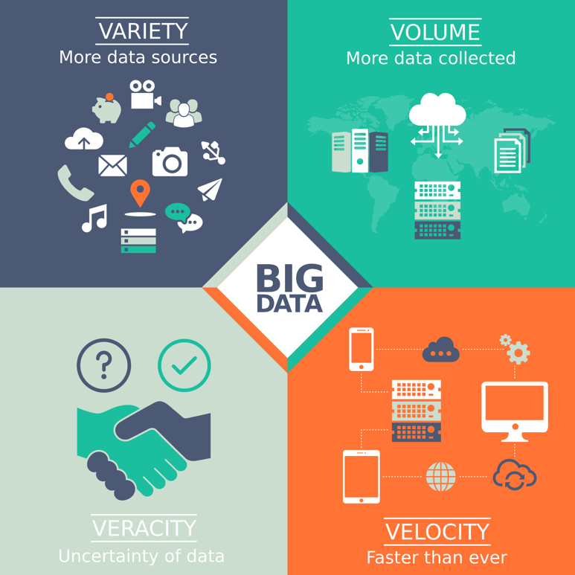
Big data is changing the world
Whenever you work with big data you must eliminate the effect of any of these aspects on your result.

Slide 29
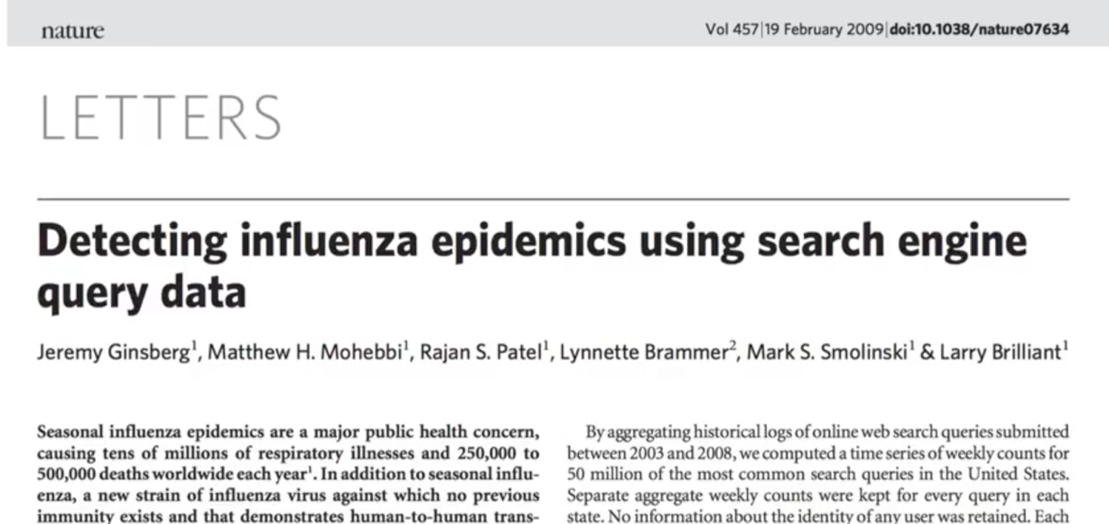
Big data is changing the world

Slide 30
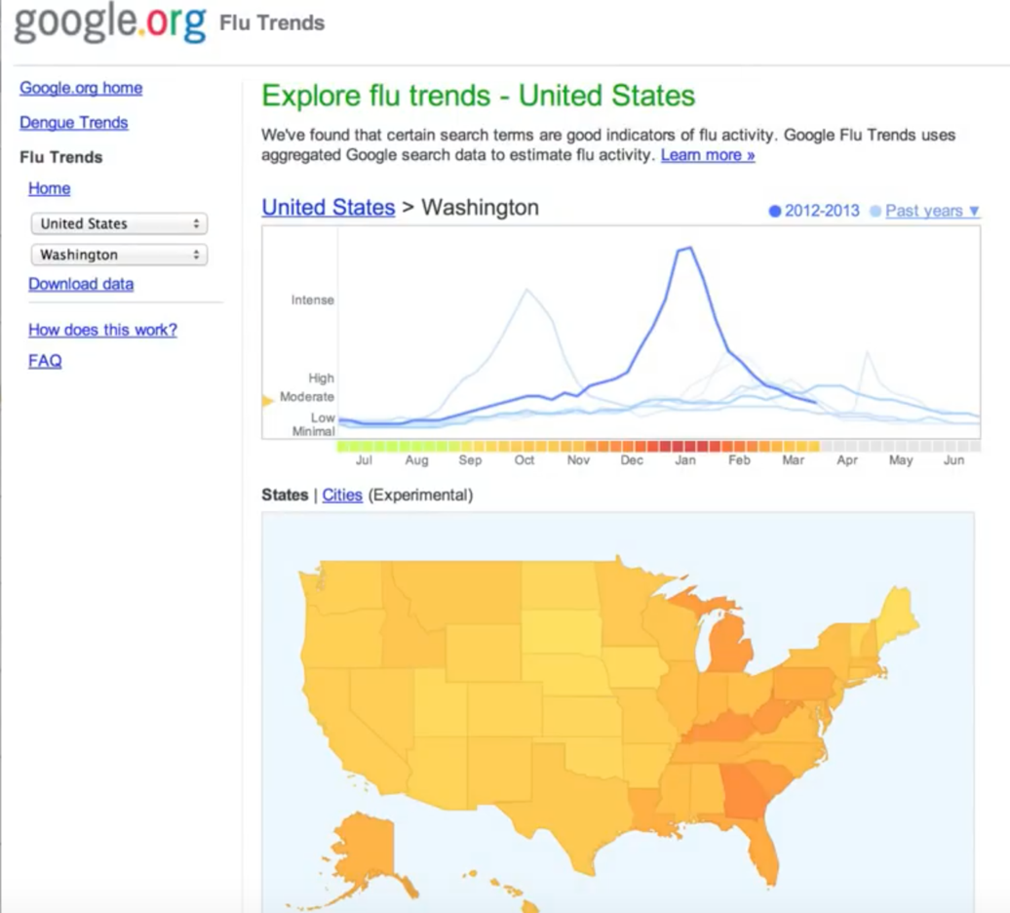
97%
Google’s claimed accuracy when compared to Centre for Disease Control data.

Slide 31
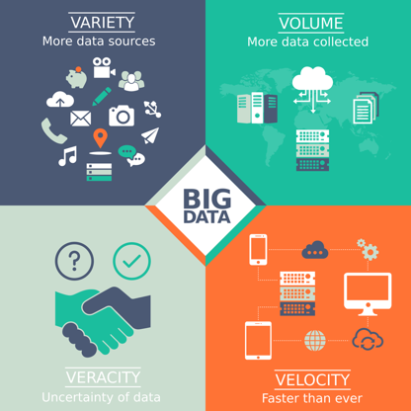
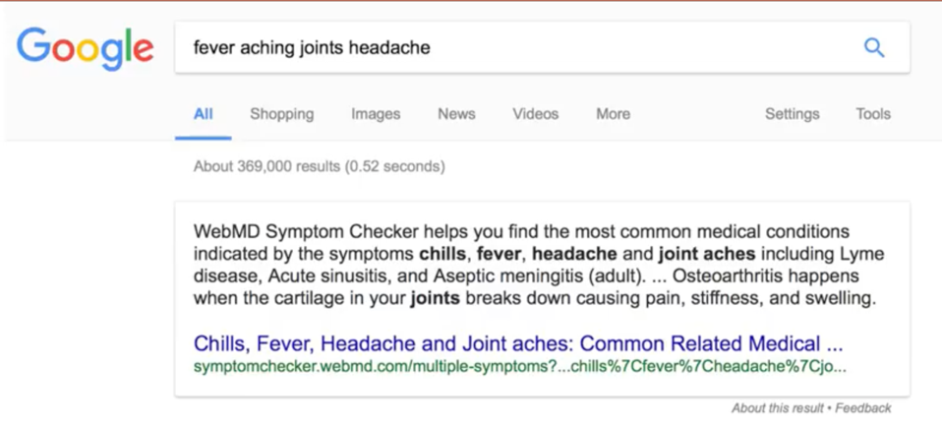

Slide 32
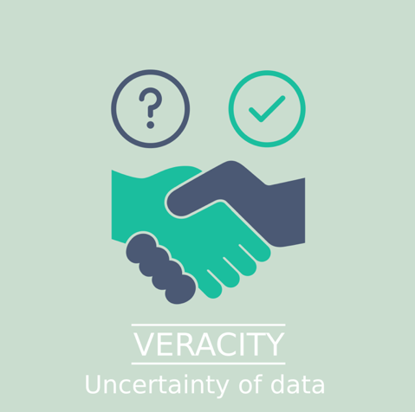
People making flu-related Google searches may know very little about how to diagnose flu?
Does a search for flu mean they have flu or just an interest in it?

Slide 33
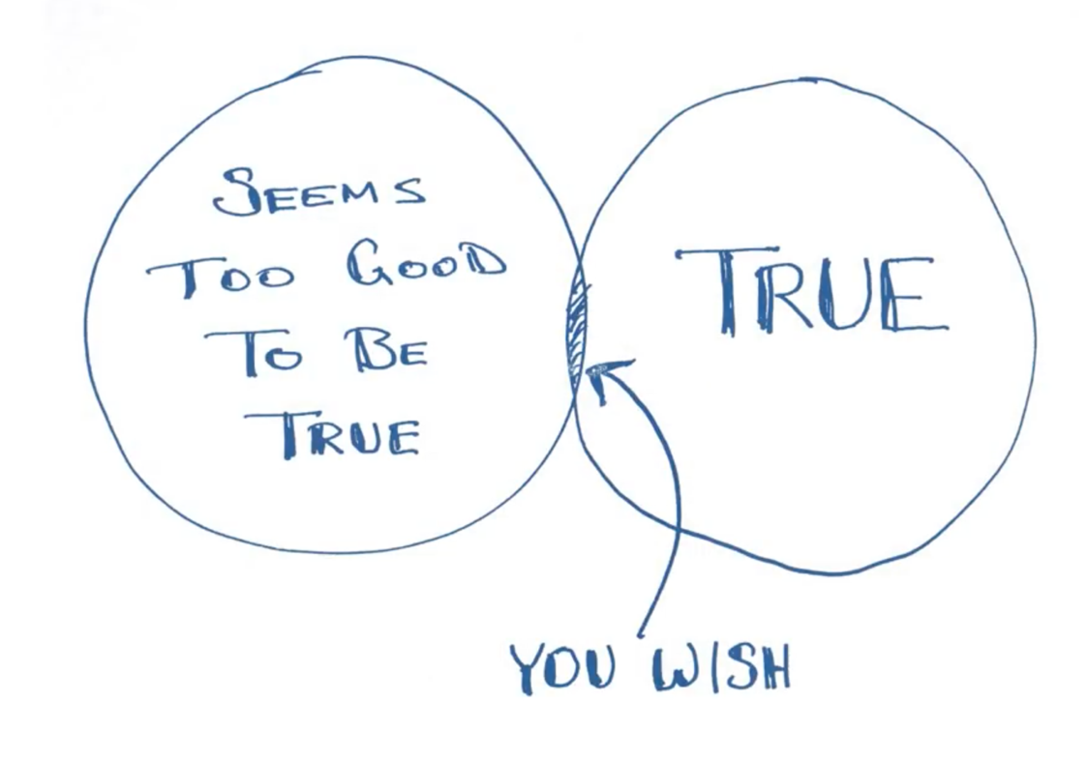

Slide 34

https://xkcd.com/552/

Slide 35
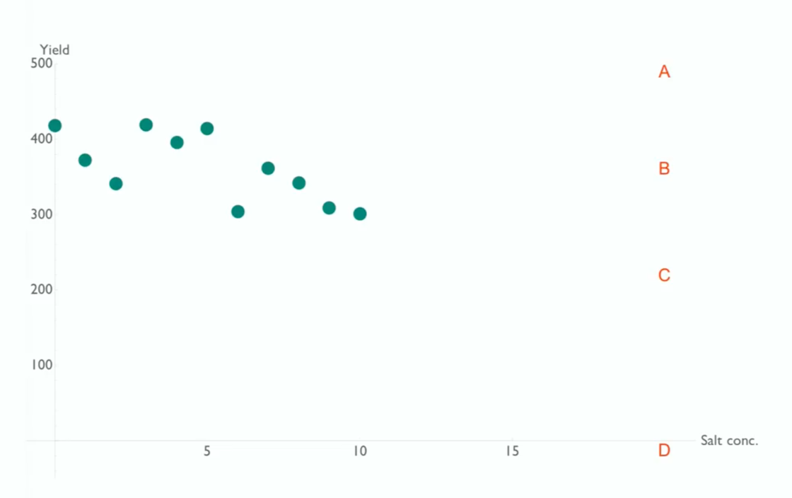
Overfitting
Plotted here are 10 points in a series that have been generated using a function.
If another 10 points were plotted of the same function which point (A,B,C or D) would they tend towards. Add a line of best fit that goes through one of these points.

Slide 36
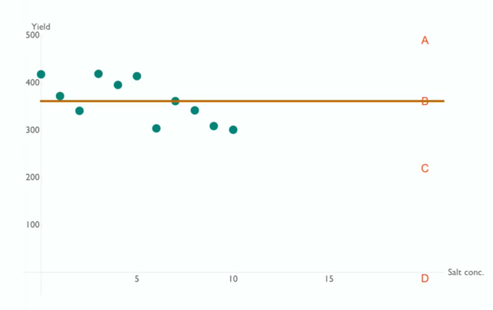
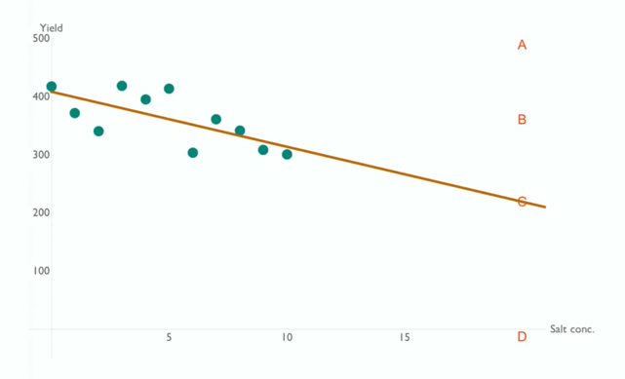
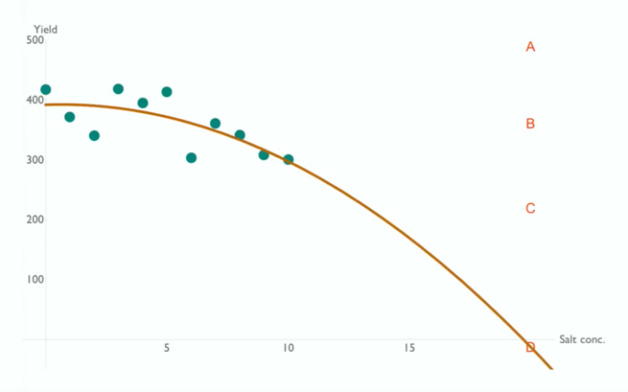
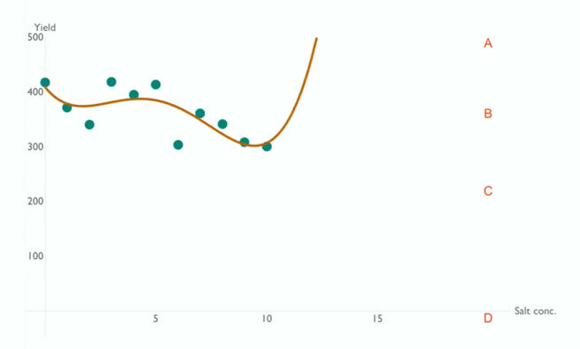
Average
Linear
c
y =
mx ± c
y =
Quadratic
Quartic
y =
ax² + bx + c
y =
ax⁵ + bx⁴ + cx³ + ….

Slide 37
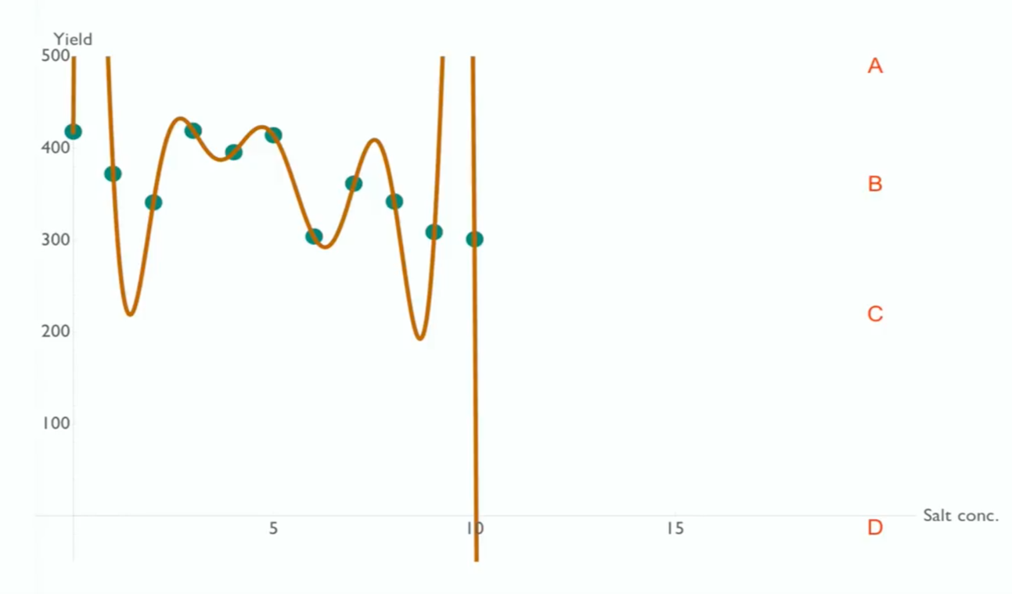
Polynomial
¹⁰ ⁹ ⁸
y = ax + bx + cx + ….

Slide 38
Why did the flu trends example fail?
Big Data Hubris (complement not supplement)
Huge veracity problem!
Used nth degree polynomial (overfitting)
Solely relied on this data over scientific method
For more on big data search YouTube for “calling bullshit on big data” Excellent lecture series from the University of Washington

Slide 39
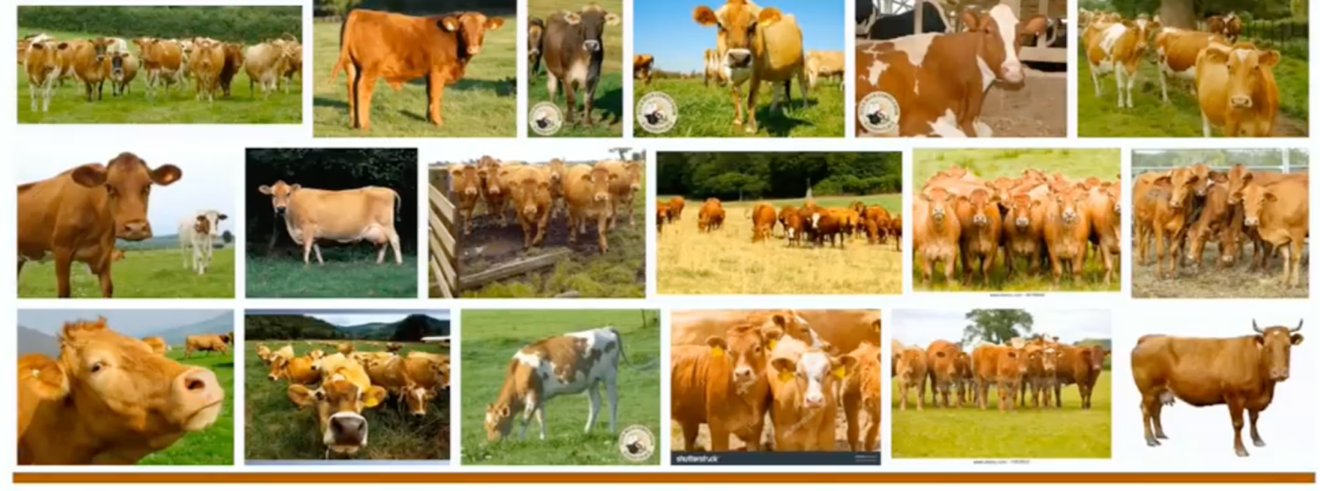
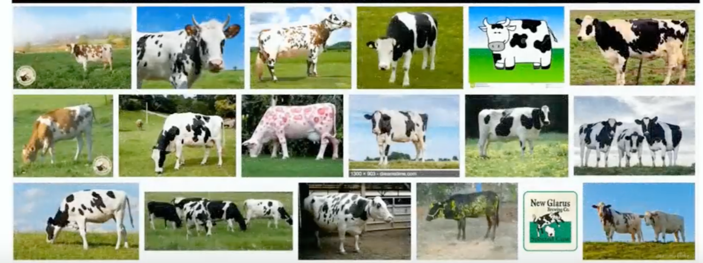

Slide 40
Data analysis 101
You each have a set of cards containing numerical values representing something. Can you work out what the dataset represents?
Data analysis stages:
Data: What do you see?
Information: What can you calculate?
Knowledge: What does it mean to you?

Slide 41
Averages
What problems does this dataset have when working out the average?
How might we solve these problems?
Is the middle value (with data points ordered) better than the mean?

Slide 42
33,750.00
44,000.00
138,188.00
45,566.67
44,000.00
141,666.67
292,500.00
5,600,000.00
103,500.00
190,000.00
65,000.00
33,750.00
195,000.00
44,000.04
4,600,000.00
194,375.00
33,750.00
112,495.50
95,000.00
301,999.00
181,500.00
33,750.00
185,000.00
205,000.00
44,000.00
33,750.00
33,750.00
33,750.00
33,750.00
44,000.00
44,000.00
44,000.00
44,000.04
45,566.67
65,000.00
95,000.00
103,500.00
112,495.50
138,188.00
141,666.67
181,500.00
185,000.00
190,000.00
194,375.00
195,000.00
205,000.00
292,500.00
301,999.00
4,600,000.00
5,600,000.00
Outliers
Average (mean): 518,311.64
Median: ~125k
16% of 25 = 4
16% trimmed mean: 128,109.09
=trimmean(RANGE,0.16)

Slide 43
The distribution of data
Divide the data into 6 evenly distributed buckets of values and stack the cards as per the diagram here.
Sugegsted buckets:
0 – 100,000
100,000 – 200,000
200,000 - 300,000
…
Card
Card
Card
Card
Card
Card
Card
Card
0 - 100k
100k - 200k
200k - 300k
300k - 400k

Slide 44
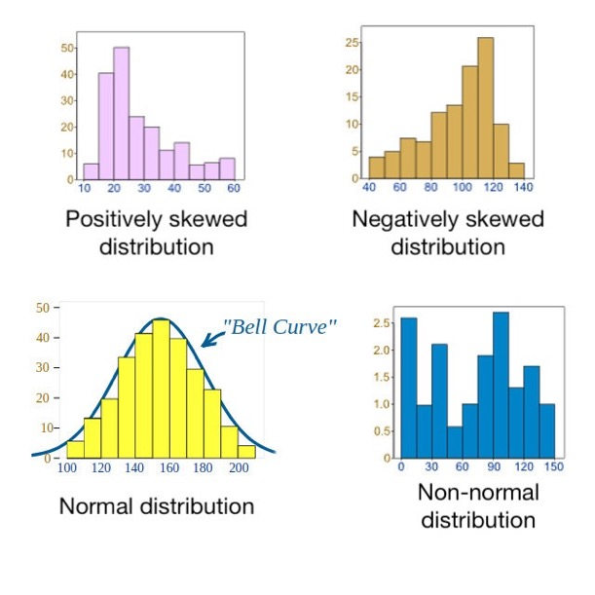
The distribution of data
Another important aspect to consider is the distribution of data. It is always a good practice to know the distribution of your data before analysing it further. Certain analyses require certain distributions.
The examples here show different types of distributions of data.

Slide 45
5 number summary (of the trimmed dataset)
Plot 3 more lines
Median
Value ¼ through dataset
Value ¾ through dataset
33,700
301,999
Flip chart paper

Slide 46
5 number summary (of the trimmed dataset)
33,700
125,000
301,999
44,000
190,000
Flip chart paper

Slide 47
5 number summary (of the trimmed dataset)
33,700
301,999
190,000
44,000
125,000

Slide 48
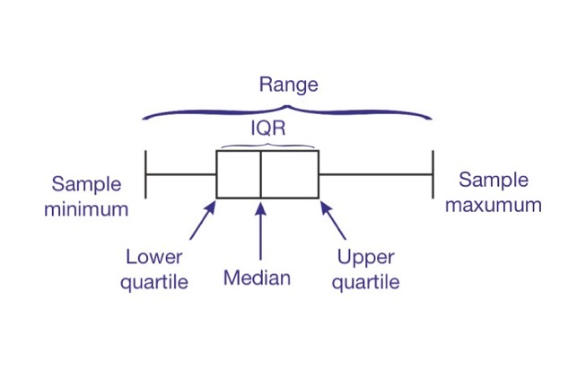
Five-number summary
The five-number summary
the sample minimum (smallest value)
the lower quartile (value ¼ through the list)
the median (middle value in the list)
the upper quartile (value ¾ through the list)
the sample maximum (largest value)

Slide 49
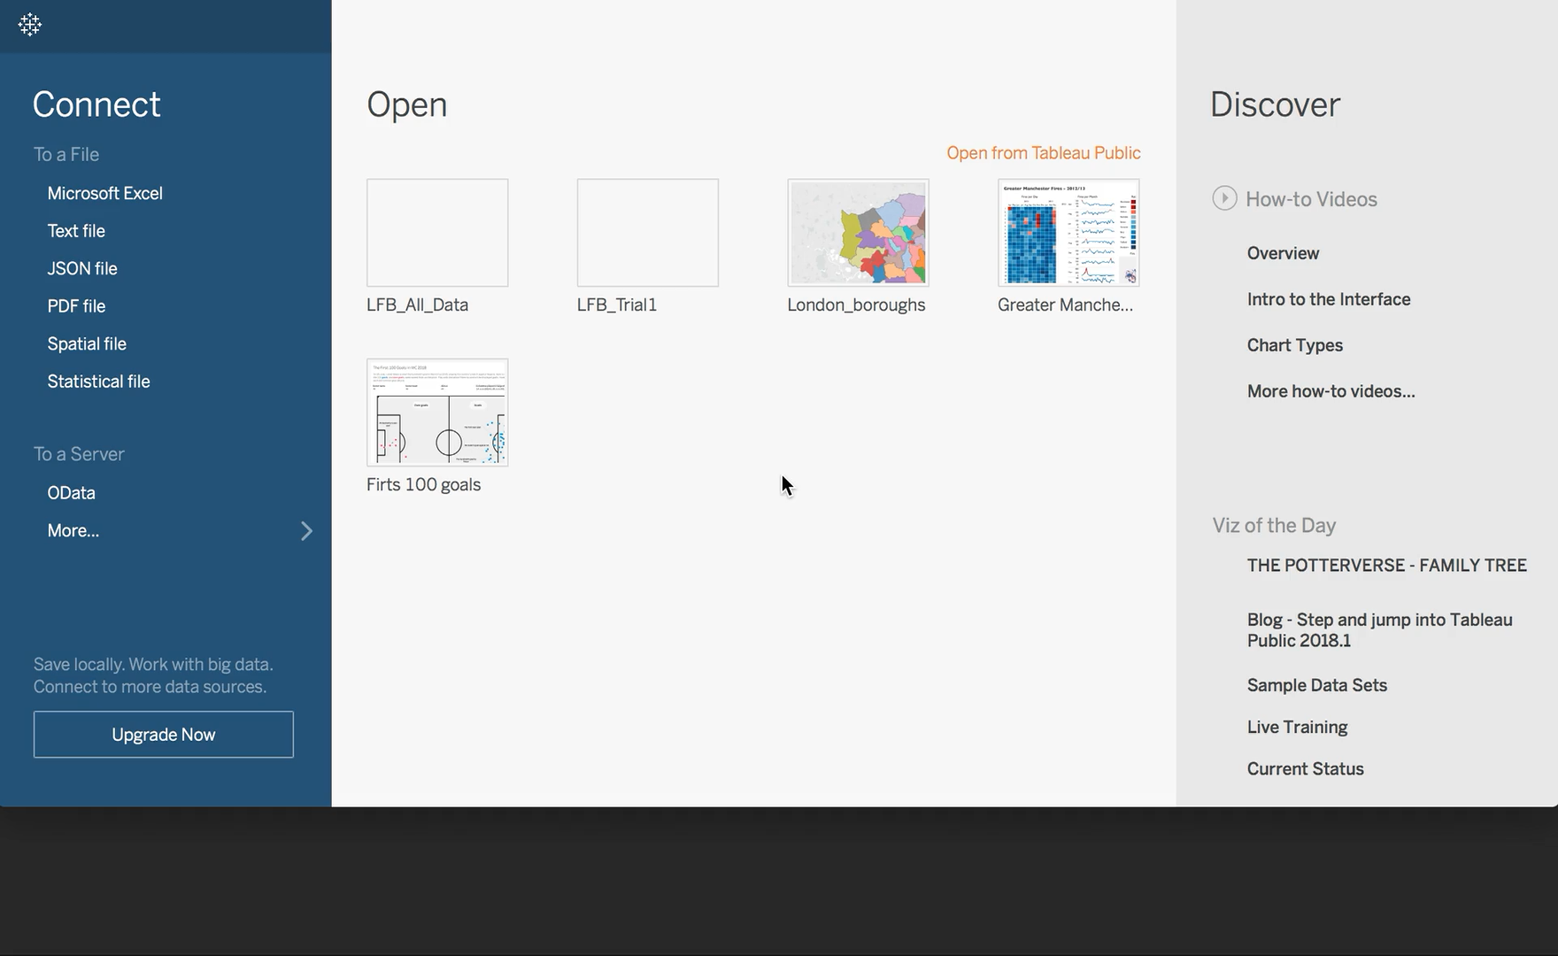
Five-number summary in Tableau

Slide 50

Summary
Data, it turns out, has shape. That shape has meaning.
The shape of data tells you everything you need to know about your data from its obvious features to its deepest secrets.

Slide 51


Slide 52
Machine learning and prediction
Each table has a set of “Top Trump” cards relating to properties in two cities.
Build a decision tree to sort them into “New York” and “San Francisco”.
You cannot use the name of the city to sort them.

Slide 53
Example decision tree
95% Confidence
Bedrooms
<=2
>2
SF: 0 NY: 7
SF: 10 NY: 3
Price
NY
<=$1m
>$1m
Correct: 19
Wrong: 1
SF: 1 NY: 3
SF: 9 NY: 0
NY
SF

Slide 54
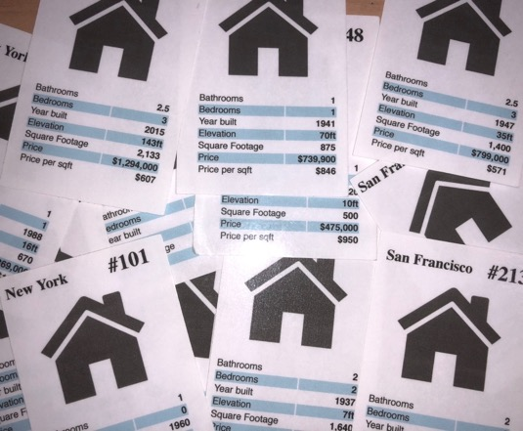
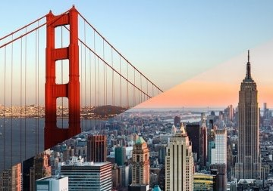
Approaches
Data first
Knowledge first

Slide 55

Assumption
What share of income tax paid in the UK is paid by the top 1% of earners?
5%
9%
14%
17%

Slide 56
Assumption
What is the average number of children per family in Bangladesh?
2
3
4
5
Notes:
Talk about population of UK being 60m and how you can get a average just by considering that.

Slide 57
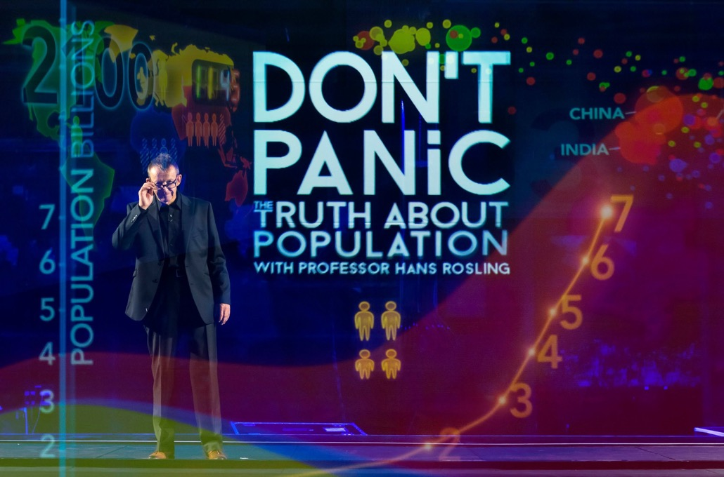
gapminder.org

Slide 58
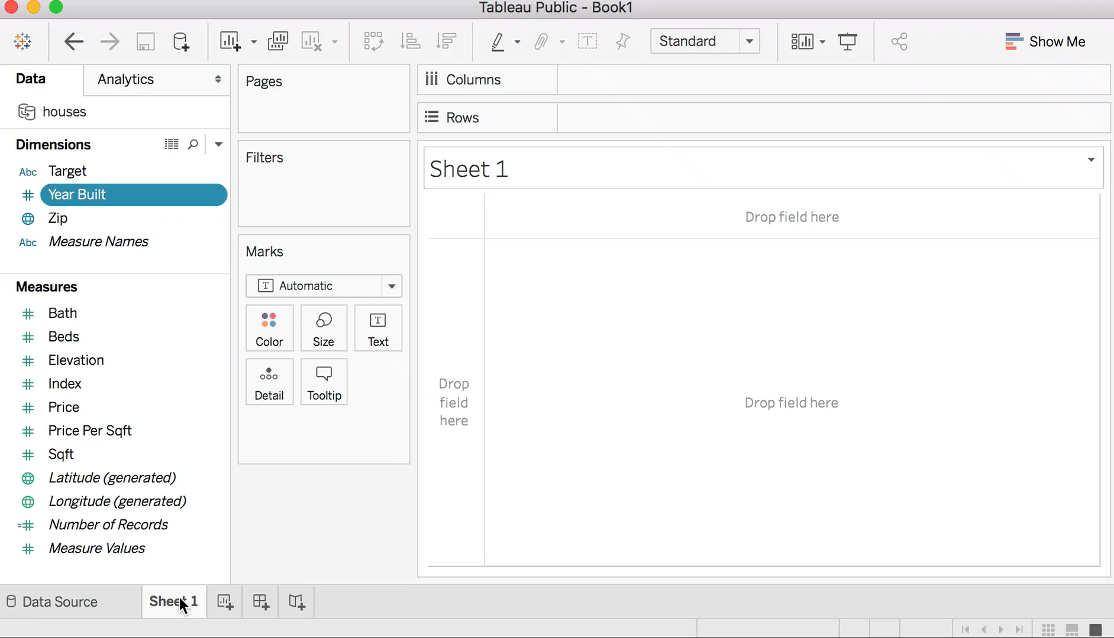
Data analysis of the houses dataset in Tableau

Slide 59
Options?
Grow the decision tree until…
every classification is perfect?
confidence level is above 80%?
it is too big to process the data in reasonable time?
4. Until the evaluation and training set have the same confidence?
5. You have used all principal components?

Slide 60
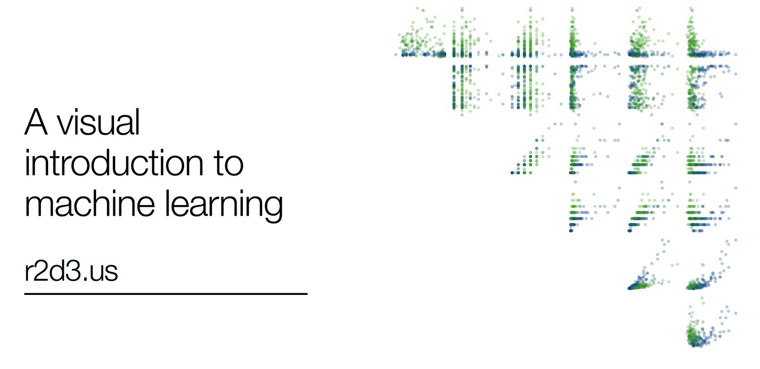

Slide 61
Considerations
Combine the data with existing knowledge but make sure the existing knowledge is correct!
Grow the tree around the principal components (using PCA). Stop when only minor improvements are achieved on the training set. Don’t overfit!

Slide 62
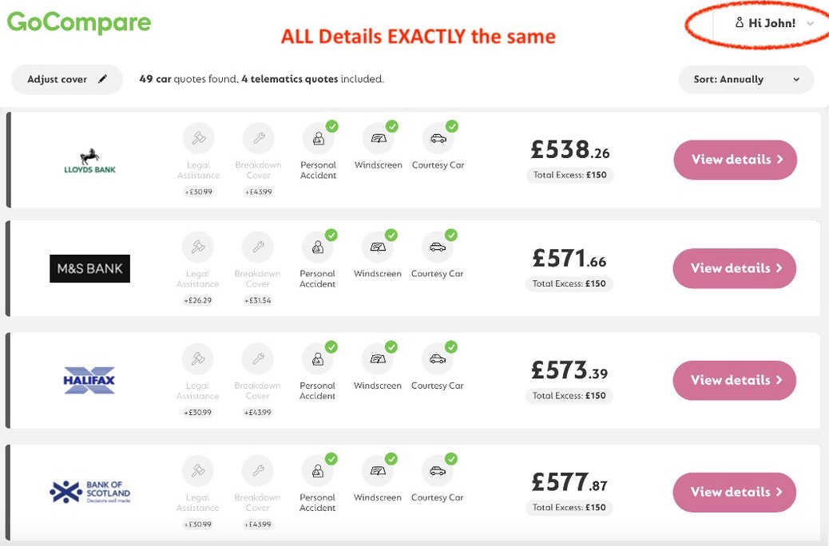

Slide 63
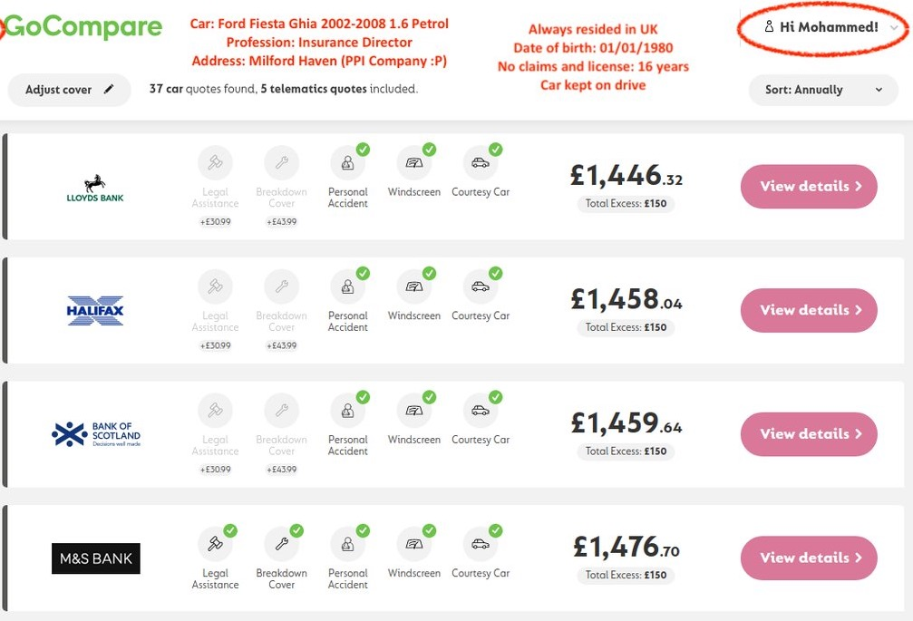

Slide 64
Good or bad ideas?
1. a tool that analyses the sentiment of a user's tweets, assesses whether they are suicidal and alerts friends | 4. a risk-assessment tool that uses AI to advise on prison sentences based upon criminal profile analysis
2. automatic pricing algorithm for taxi firm which responds to surges in demand | 5. using energy efficiency data and winter fuel allowance data to target efficiency advice
3. using performance data to advise on how to save money in the emergency services | 6. publishing genomes of 100,000 individuals for use in public health

Slide 65


Slide 66
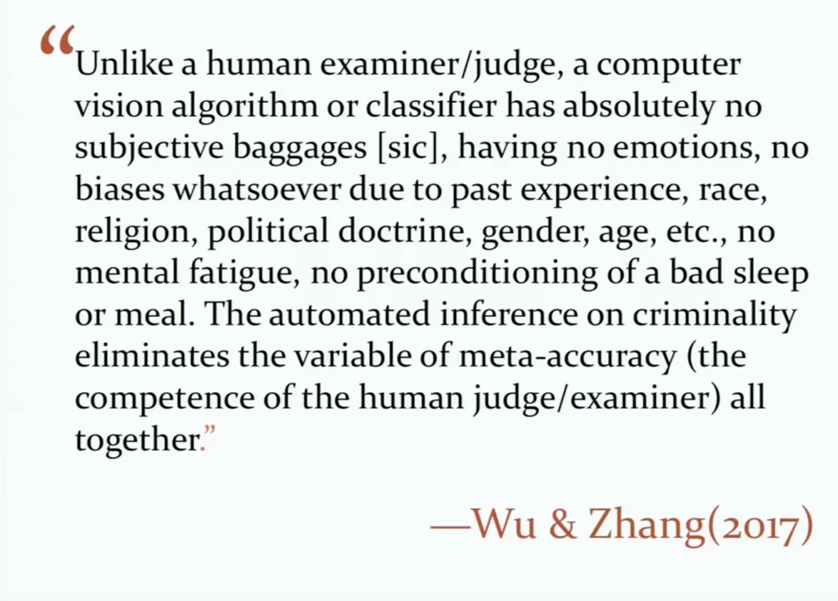

Slide 67
Utter Bull..
Example from “calling bullshit” lecture series from the University of Washington

Slide 68
Good or bad ideas?
1. a tool that analyses the sentiment of a user's tweets, assesses whether they are suicidal and alerts friends | 4. a risk-assessment tool that uses AI to advice on prison sentences based upon criminal profile analysis
2. automatic pricing algorithm for taxi firm which responds to surges in demand | 5. using energy efficiency data and winter fuel allowance data to target efficiency advice
3. using performance data to advice on how to save money in the emergency services | 6. publishing genomes of 100,000 individuals for use in public health

Slide 69
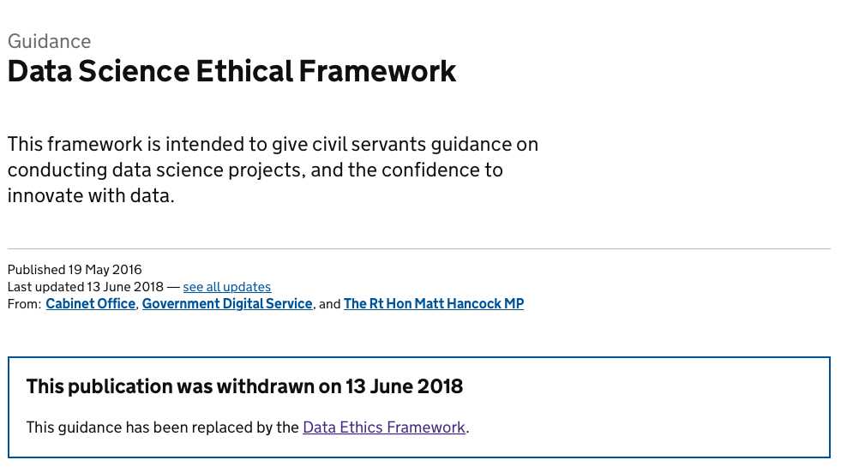
Data ethics
More on the examples used in this section (as well as more examples) -
https://www.gov.uk/government/publications/data-science-ethical-framework

Slide 70
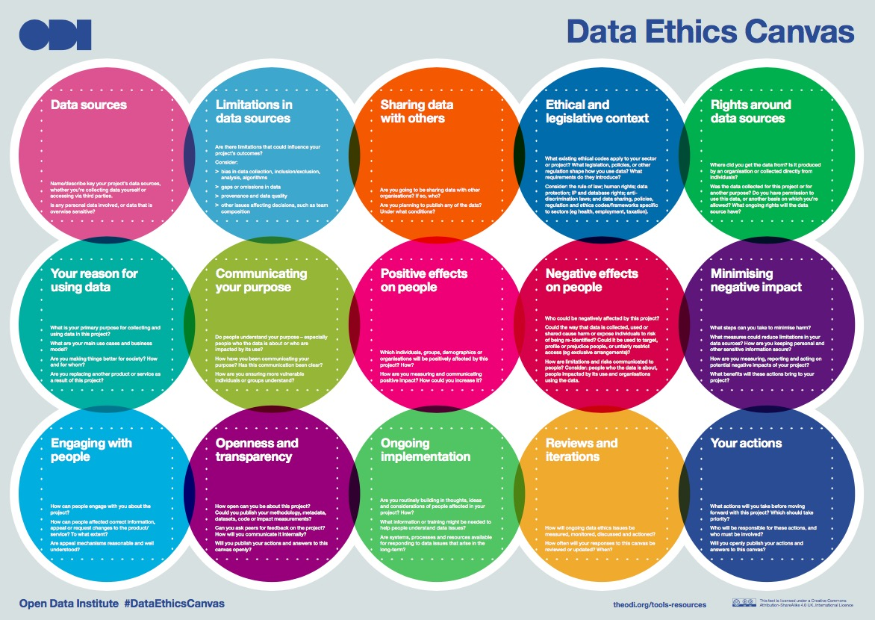
Data ethics canvas
https://theodi.org/article/data-ethics-canvas/

Slide 71
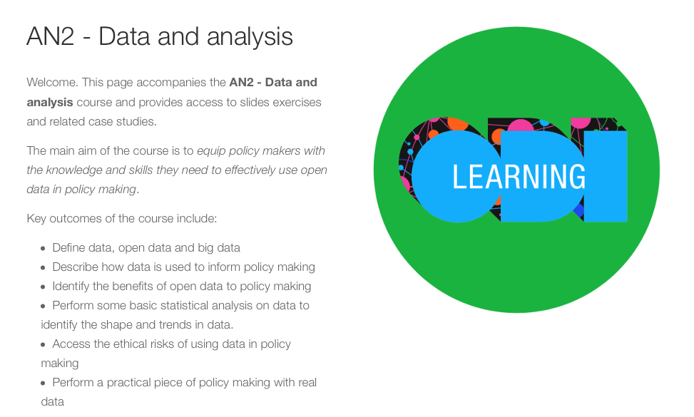
Course materials
NOTE; CSL should be the only logo on the cover page
http://training.theodi.org/csl-an2/

Slide 72
Data analysis in practice
Outcomes
List the stages in carrying out data analysis for policy making.
Create a plan for carrying out data analysis for policy making.
Review the role of open data in policy making
Carry out a simple data analysis using a number of tools.
Create an interactive data visualisation.
Communicate the results of a data analysis to decision makers.
Homework

Slide 73
What has been the impact of closing 10 fire stations in London?
NOTE; CSL should be the only logo on the cover page

Slide 74

Data analysis practical
You have been tasked with saving money in the local fire service.
You must propose a solution that saves money while minimising the impact on service delivery.
Which factor do you think is the most significant in analysing performance to identify savings (top of the decision tree)
Paul Hudson

Slide 75
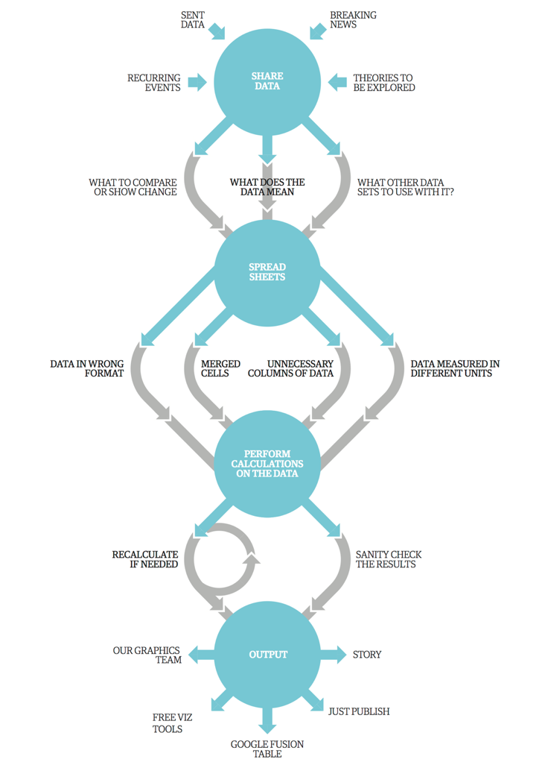
Using data in analysis
Collect data.
Establish context of data.
Clean the data.
Translate, filter and merge data.
Initial evaluation.
Go back to start?
Secondary evaluation and analysis.
Sanity check.
Create output.
Guardian

Slide 76
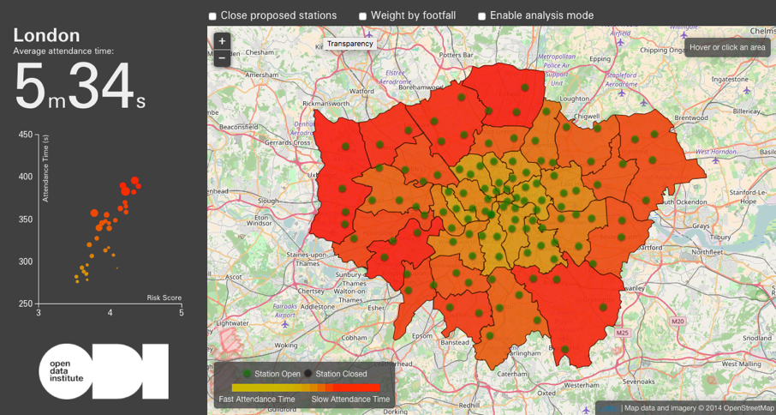
http://london-fire.labs.theodi.org/explore/

Slide 77
Stage 1: collect data
Make a space on your group desk
Put a yellow post-it note in the middle and draw a fire on it. Write a time on it between 4 minutes and 7 minutes.
Scatter a series of all different colour (including yellow) post-it around this one to keep it in the middle. Write a time between 4 and 7 minutes on each one.
Each post-it note represents an incident that has been responded to by the London fire brigade.
Each colour represents a different fire stations from which the appliance (fire engine) was sent
Stage 2: establish context

Slide 78
Stage 3: clean the data
Given the context does your data make sense?
Nothing to do…
Stage 4: Translate, filter and merge data

Slide 79
Stage 5: initial evaluation
How do we calculate the impact of closing the YELLOW fire station (and specifically the middle incident)?
What is your design?

Slide 80
Stage 8: Sanity check
Does you design overfit (or use nth degree polynomial?)
Can your design really model the future or just show how the past was?

Slide 81
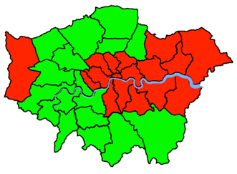
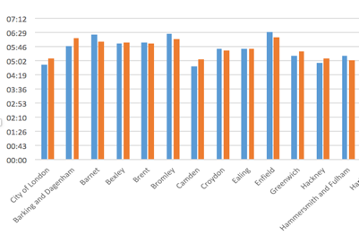
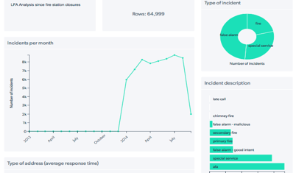
Stage 9: Creating output
There are many options for output. Consider the best one for your purpose.
A map can be ideal for such geographic datasets (search for London Data Store borough Excel KML).
A chart showing a comparison of before an after statistics can be easily generated in excel.
An highly interactive dashboard can be created with dataseedapp.com.

Slide 82
Review
NOTE; CSL should be the only logo on the cover page
London Fire Stations analysis was a story started by a participant in an ODI Training course like this one. What is your story? Who and what would you need to help you?
If I’m a policy maker, what do I now need to go and do?
What do I need to go and do next?
What is your main takeaway from the course overall?
What are you going to apply back in the workplace?

Slide 83
Open data in policy cycles
NOTE; CSL should be the only logo on the cover page

Slide 84
Public policy cycle
DESIGN
EVALUATION
IMPLEMENTATION
Slide courtesy of Andrea Barenque

Slide 85
Question
What role can open data play in each stage of the policy cycle?
DESIGN
EVALUATION
IMPLEMENTATION

Slide 86
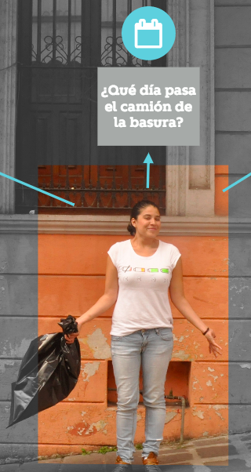
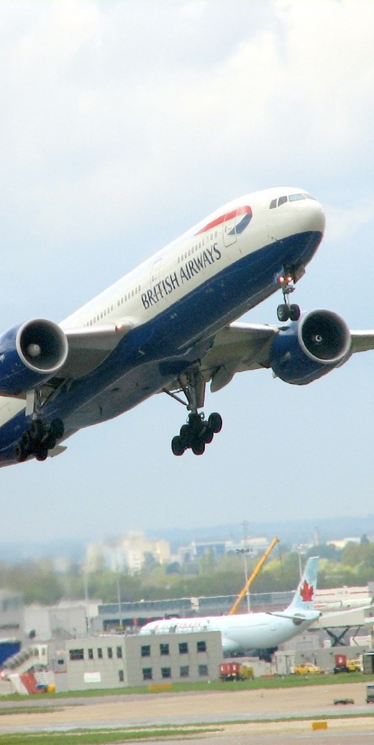
The city of Xalapa’s waste management problem
Rubbish collection was frustrating the public as there was no clarity how the service operated.
The main problems:
Where is the rubbish collected from?
When is the rubbish collection?
What day is the rubbish collected?
What time is the rubbish collected?
Create a policy cycle/s
What role can open data play?
flickr: lucianf
Slide courtesy of Andrea Barenque

Slide 87
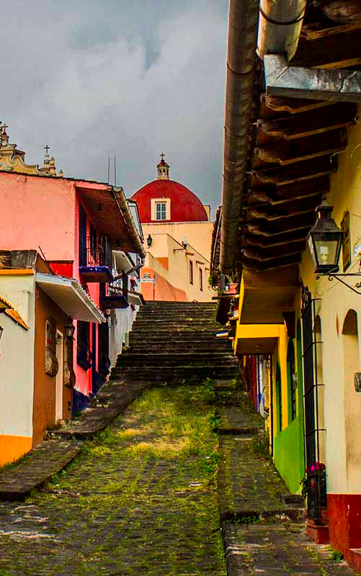
Put a GPS on every garbage truck (design)
Collected the data (implementation)
Opened the data (implementation)
Engaged community in design (design)
Analyzed the maps for new routes (evaluation & design)
Implemented new routes (implementation)
Evaluated the impact, repeating 1-3 (evaluation)
Civil society organizations organized a Hackathon (design)
Developed an app (exact location, timetables, citizens reports) (implementation)
Evaluated the solution (evaluation)
flickr: lucianf
Slide courtesy of Andrea Barenque

Slide 88
Put a GPS on every garbage truck (design)
Collected the data (implementation)
Opened the data (implementation)
Engaged community in design (design)
Analyzed the maps for new routes (evaluation & design)
Implemented new routes (implementation)
Evaluated the impact, repeating 1-3 (evaluation)
Civil society organizations organized a Hackathon (design)
Developed an app (exact location, timetables, citizens reports) (implementation)
Evaluated the solution (evaluation)
Is open data just an input in this cycle?
If not what does this change?
Slide courtesy of Andrea Barenque

Slide 89
1. Input data for evidence based policy making
Data is drawn from a number of sources and is analysed to inform policy making.
Examples include:
environmental impact of third runway at Heathrow
impact of London fire station closures
how to regulate peer to peer lending
flickr: lucianf

Slide 90
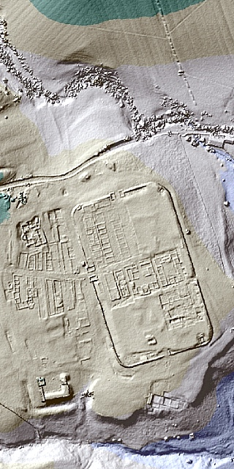
2. Output data for transparency and to encourage citizen interaction
Data is published as part of a transparency or other open government agenda. There is no immediate desire for the data to have any other impact.
Examples include:
government spending data
planning application data
LIDAR data
flickr: lucianf

Slide 91

3. Tool to change behaviour
Where the data is the catalyst for change required by the policy.
Examples include:
plastic bag usage data
waste and emissions data
pay gap data
mobile coverage data
broadband speed data
US Fish and Wildlife Service

Slide 92
Thank you
We hope you enjoyed this experience brought to you by
Delivered by
Now over to you! What are you going to do differently?

